Slide 1
MP/BME 710: Journal club
Magnetic Resonance Elastography of Liver:
Technique, Analysis, and Clinical Applications
Sudhakar K. Venkatesh, MD, Meng Yin, PhD, and Richard L. Ehman, MD
Grant Roberts
Department of Medical Physics

Slide 2
Introduction
Typically short TR, short TE, and low flip angle
Total time ~ 1 minute
Move only microns displacement
30 – 500 Hz

Slide 3
Introduction

Slide 4
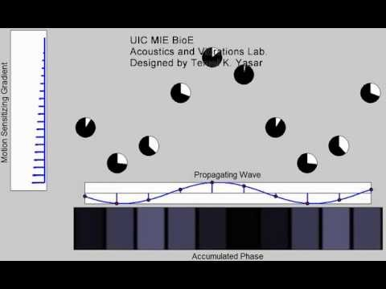
Introduction

Slide 5
Introduction

